Slide 1
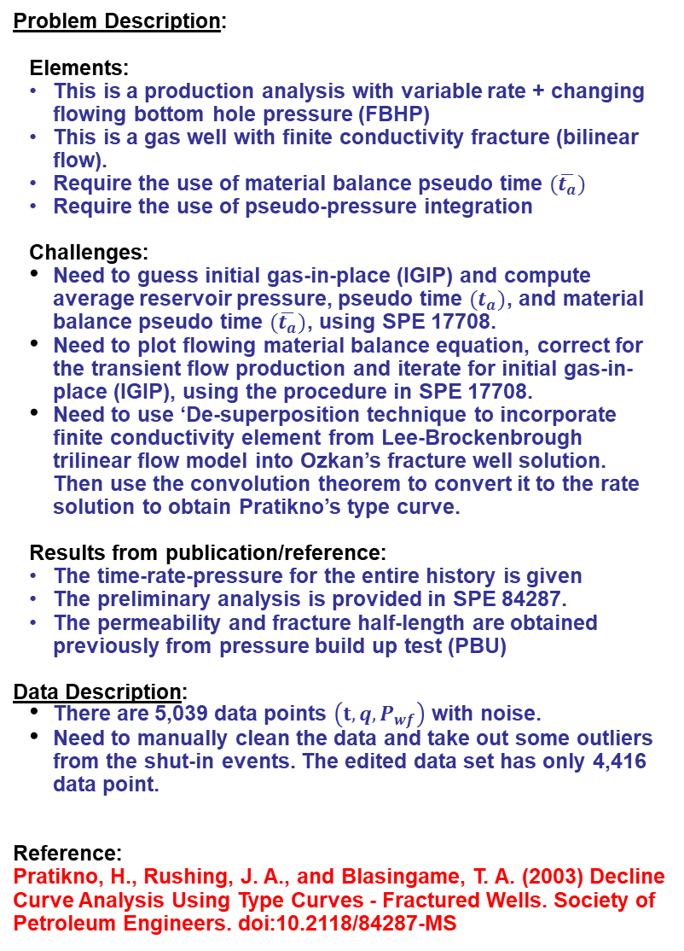
Problem Description/Data/Reference: Final Project (RTA) - SPE 114947 (Ilk)
Problem Description:
Elements:
This is a production analysis with variable rate + changing flowing bottom hole pressure (FBHP)
This is a gas well with finite conductivity fracture (bilinear flow).
Require the use of material balance pseudo time $(\overline{t_{a}})$
Require the use of pseudo-pressure integration
Challenges:
Need to guess initial gas-in-place (IGIP) and compute average reservoir pressure, pseudo time $(t_{a})$, and material balance pseudo time $(\overline{t_{a}})$, using SPE 17708.
Need to plot flowing material balance equation, correct for the transient flow production and iterate for initial gas-in-place (IGIP), using the procedure in SPE 17708.
Need to use ‘De-superposition technique to incorporate finite conductivity element from Lee-Brockenbrough trilinear flow model into Ozkan’s fracture well solution. Then use the convolution theorem to convert it to the rate solution to obtain Pratikno’s type curve.
Results from publication/reference:
The time-rate-pressure for the entire history is given
The preliminary analysis is provided in SPE 84287.
The permeability and fracture half-length are obtained previously from pressure build up test (PBU)
Data Description:
There are 5,039 data points $\left(t, q,P_{wf}\right)$ with noise.
Need to manually clean the data and take out some outliers from the shut-in events. The edited data set has only 4,416 data point.
Reference:
Pratikno, H., Rushing, J. A., and Blasingame, T. A. (2003) Decline Curve Analysis Using Type Curves - Fractured Wells. Society of Petroleum Engineers. doi:10.2118/84287-MS
Table of Properties
Fluid Properties:
REF. GAS FVF, MSCF/STB = 0.5483
REF. GAS VISCOSITY, cp = 0.03605
REF. TOTAL COMPRESSIBILITY, 1/psia = 5.0975E-5
TEMPERATURE, deg F = 300
Reservoir Properties:
RESERVOIR THICKNESS, ft = 170
WELLBORE RADIUS, ft = 0.333
POROSITY, fraction = 0.088
EQUIVALENT POROSITY, fraction = 0.07647 (*)
(*) Adjusted to the irreducible water saturation
Swi = 0.131
Production Properties:
INITIAL PRESSURE (Pi), psia = 9330
PSEUDO INITIAL PRESSURE (Ppi),psia = 7540.13
INITIAL GAS-IN-PLACE (G), BSCF = 3.23 (*)
(*) INTIAL GUESS FROM SPE 17708 METHOD
Properties to be Solved: (Final Estimates)
(from Python Program)
(Finite-conductivity fracture in a bounded
reservoir model)
PERMEABILITY (k), md = 0.016
FRACTURE HALF-LENGTH (xf), ft = 112
EQUIVALENT SKIN (S), Dim-Less = -5.12 (*)
FRACTURE COND.(FcD), Dim-less = 27
RESERVOIR RADIUS (re), ft = 491
INITIAL GAS-IN-PLACE (G), BSCF = 3.20 (**)
(*) Calculated from S = -ln(xf/2rw)
(**) Use volumetric calculation from reservoir properties and matched reservoir radius (re)

Slide 2
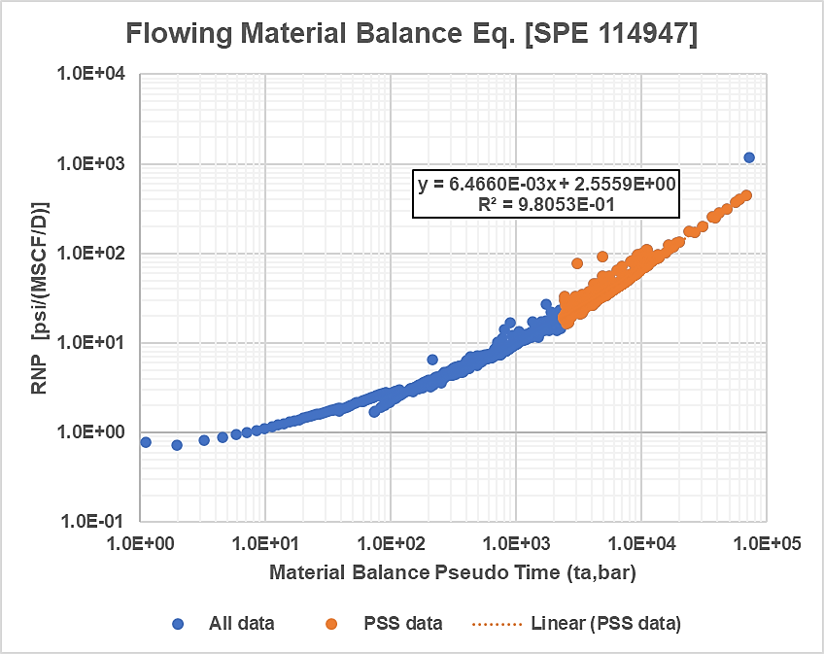
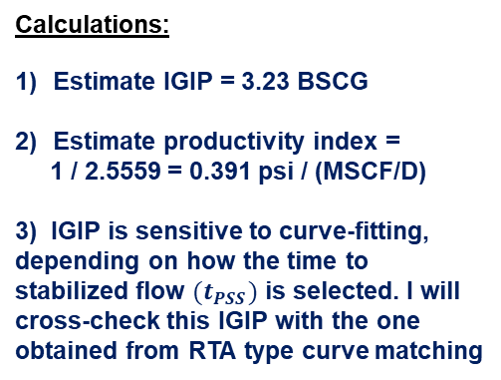
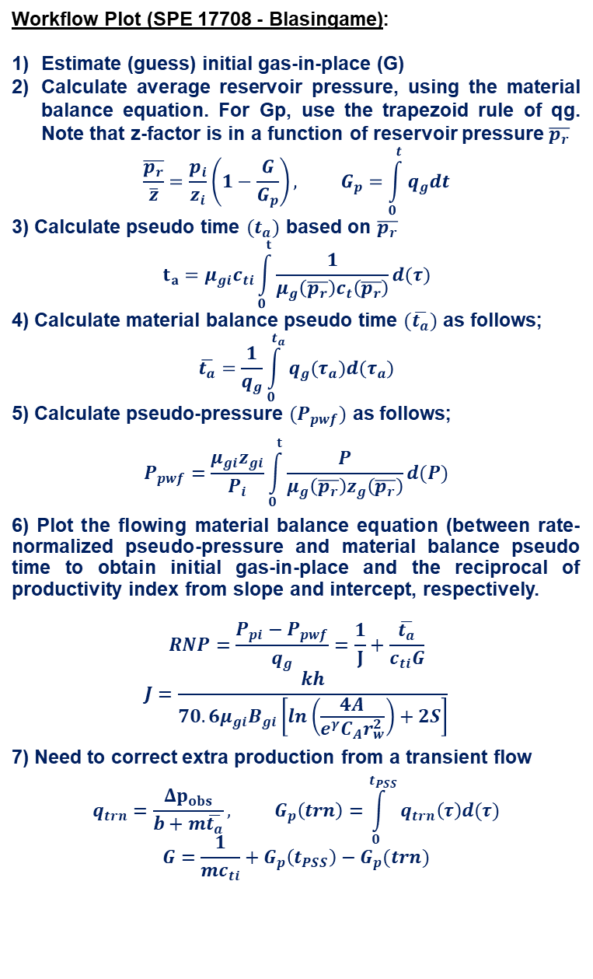
Material Balance Pseudo Time $(\overline{t_{a}})$ and Initial Gas-In-Place Iterations (G)
Diagnostic Plot [log-log]:
Workflow Plot (SPE 17708 - Blasingame):
Estimate (guess) initial gas-in-place (G)
Calculate average reservoir pressure, using the material balance equation. For Gp, use the trapezoid rule of qg. Note that z-factor is in a function of reservoir pressure $\overline{p_{r}}$
$$\frac{\overline{p_{r}}}{\overline{z}}=\frac{p_{i}}{z_{i}}\left(1−\frac{G}{G_{p}}\right), G_{p}=\int_{0}^{t}{q_{g}dt}$$
3) Calculate pseudo time $(t_{a})$ based on $\overline{p_{r}}$
$$t_{a}=μ_{gi}c_{ti}\int_{0}^{t}{\frac{1}{μ_{g}\left(\overline{p_{r}}\right)c_{t}\left(\overline{p_{r}}\right)}d(τ)}$$
4) Calculate material balance pseudo time $(\overline{t_{a}})$ as follows;
$$\overline{t_{a}}=\frac{1}{q_{g}}\int_{0}^{t_{a}}{q_{g}(τ_{a})d(τ_{a})}$$
5) Calculate pseudo-pressure $(P_{pwf})$ as follows;
$$P_{pwf}=\frac{μ_{gi}z_{gi}}{P_{i}}\int_{0}^{t}{\frac{P}{μ_{g}\left(\overline{p_{r}}\right)z_{g}\left(\overline{p_{r}}\right)}d(P)}$$
6) Plot the flowing material balance equation (between rate-normalized pseudo-pressure and material balance pseudo time to obtain initial gas-in-place and the reciprocal of productivity index from slope and intercept, respectively.
$$RNP=\frac{P_{pi}−P_{pwf}}{q_{g}}=\frac{1}{J}+\frac{\overline{t_{a}}}{c_{ti}G}$$
$$J=\frac{kh}{70.6μ_{gi}B_{gi}\left[ln\left(\frac{4A}{e^{γ}C_{A}r_{w}^{2}}\right)+2S\right]}$$
7) Need to correct extra production from a transient flow
$$q_{trn}=\frac{Δp_{obs}}{b+m\overline{t_{a}}}, G_{p}\left(trn\right)=\int_{0}^{t_{PSS}}{q_{trn}\left(τ\right)d(τ)}$$
$$G=\frac{1}{mc_{ti}}+G_{p}\left(t_{PSS}\right)−G_{p}(trn)$$
Calculations:
Estimate IGIP = 3.23 BSCG
Estimate productivity index =
1 / 2.5559 = 0.391 psi / (MSCF/D)
3) IGIP is sensitive to curve-fitting, depending on how the time to stabilized flow $(t_{PSS})$ is selected. I will cross-check this IGIP with the one obtained from RTA type curve matching

Slide 3
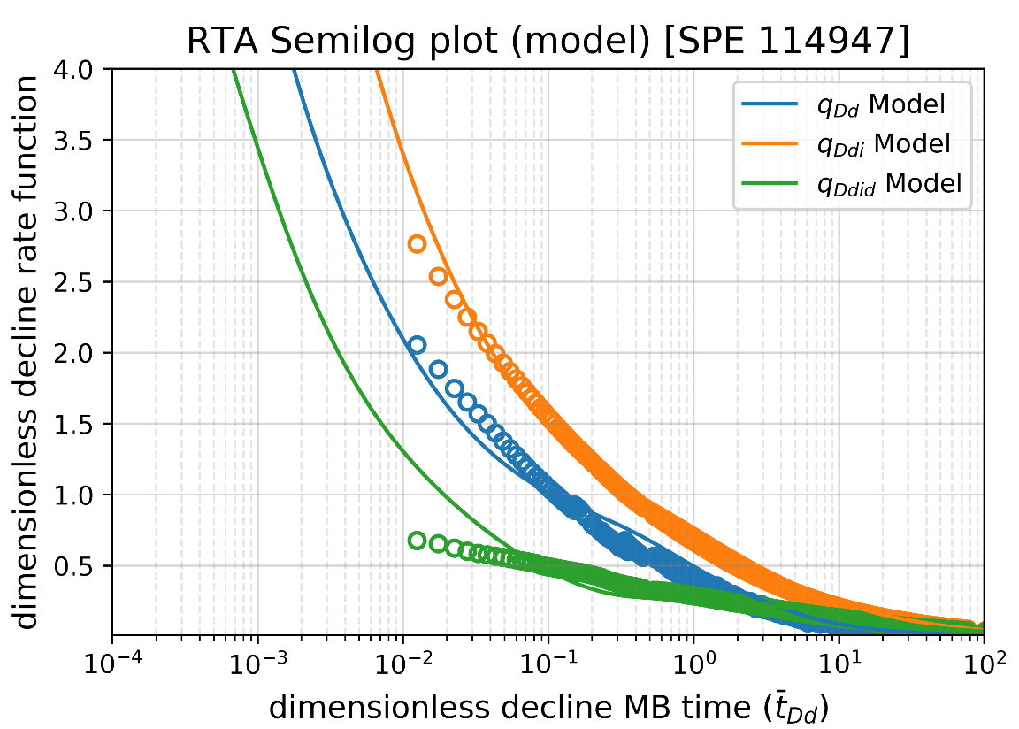
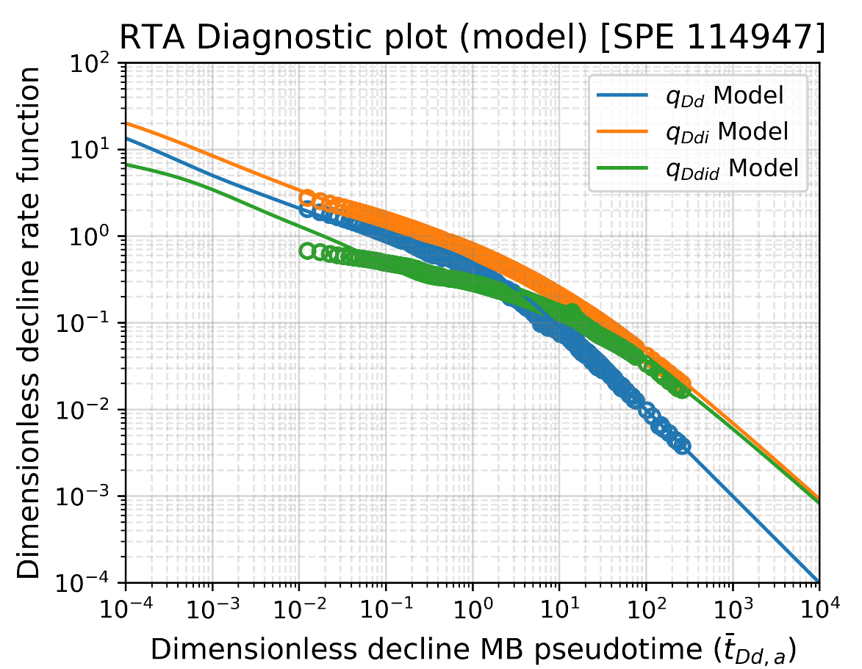
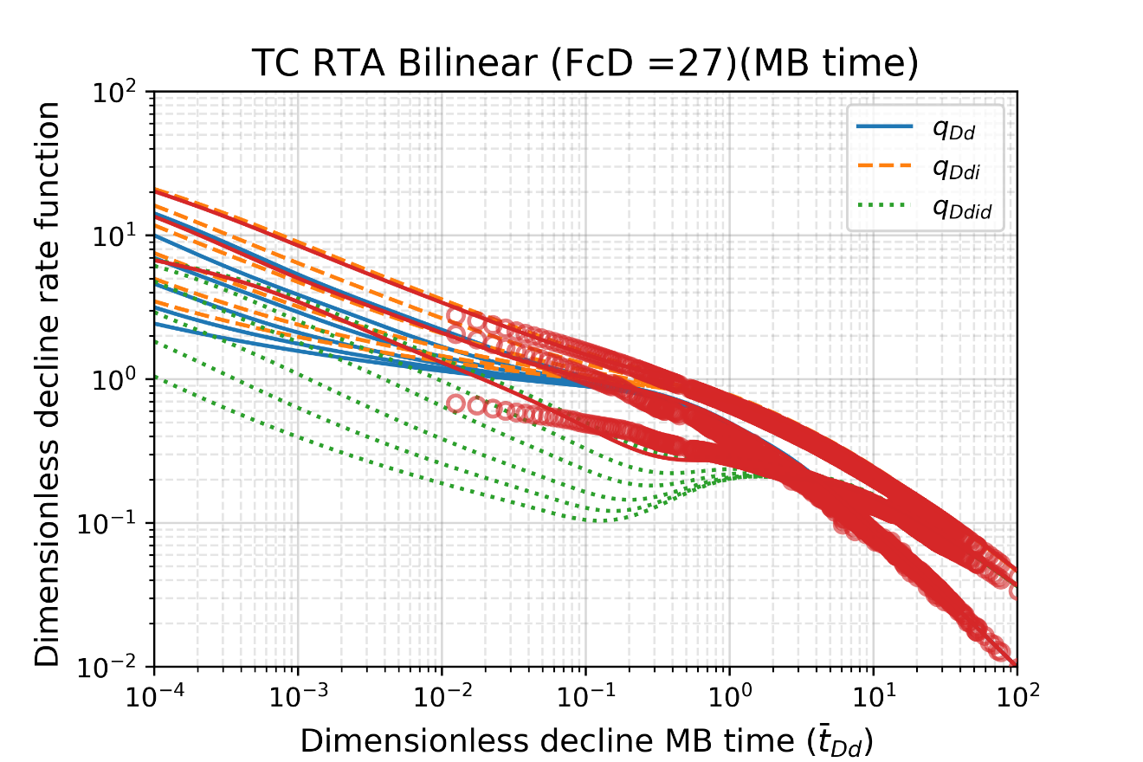
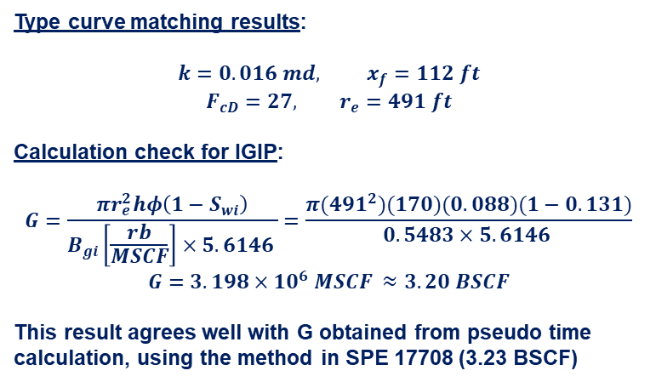
Analysis Summary Plots (Model)
“Model” matching: (by Python)
Finite conductivity
Excellent match throughout history!
qDdid is off a bit toward the beginning
(numerical artifact)
Excellent match throughout history!
b = 1 (MB. Time)
Type curve matching results:
$$k=0.016 md, x_{f}=112 ft$$
$$F_{cD}=27, r_{e}=491 ft$$
Calculation check for IGIP:
$$G=\frac{πr_{e}^{2}hφ\left(1−S_{wi}\right)}{B_{gi}\left[\frac{rb}{MSCF}\right]×5.6146 }=\frac{π(491^{2})(170)(0.088)(1−0.131)}{0.5483×5.6146 }$$
$G=3.198×10^{6} MSCF ≈3.20 BSCF$
This result agrees well with G obtained from pseudo time calculation, using the method in SPE 17708 (3.23 BSCF)
Using Pratikno TC
Excellent overlay on TC

Slide 4
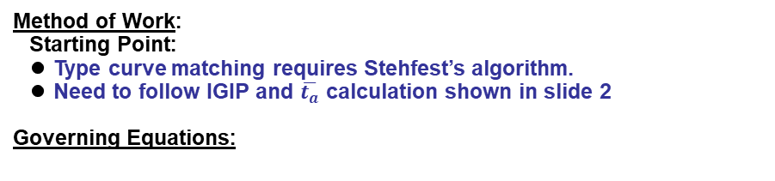
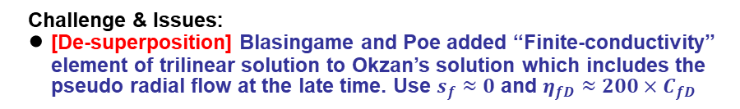
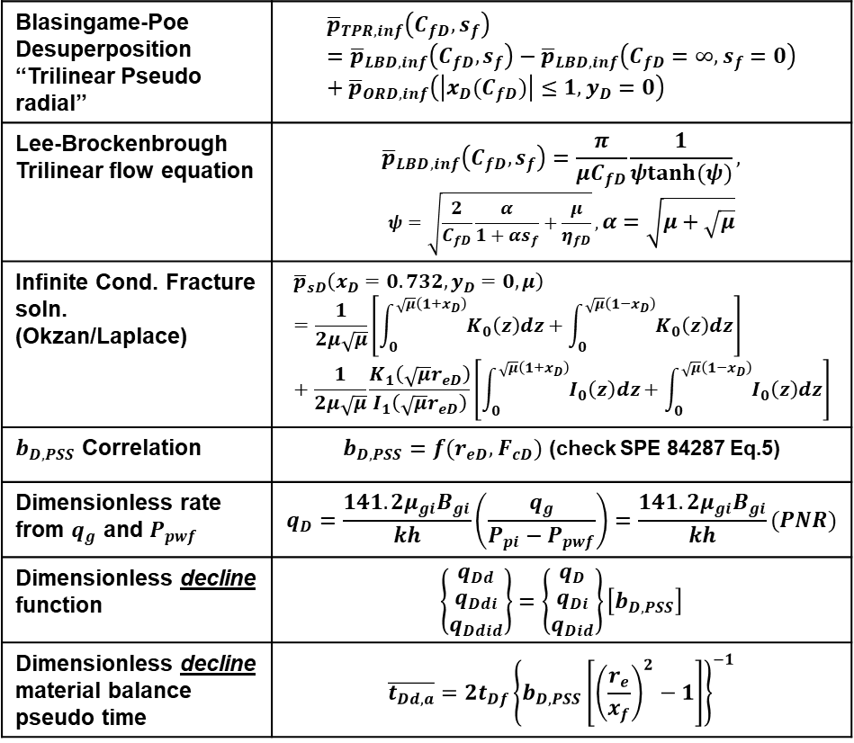
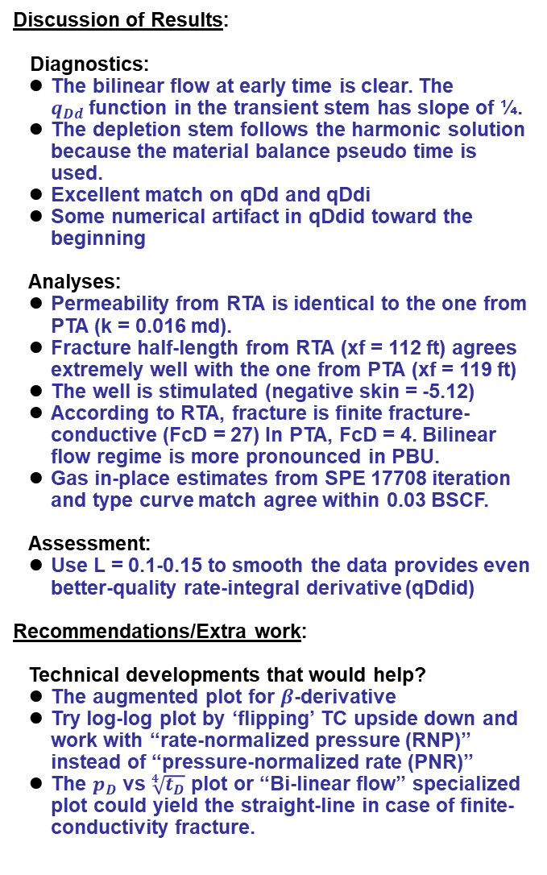
Method of Work / Discussion of Results
Method of Work:
Starting Point:
Type curve matching requires Stehfest’s algorithm.
Need to follow IGIP and $\overline{t_{a}}$ calculation shown in slide 2
Governing Equations:
Discussion of Results:
Diagnostics:
The bilinear flow at early time is clear. The $q_{Dd}$function in the transient stem has slope of ¼.
The depletion stem follows the harmonic solution because the material balance pseudo time is used.
Excellent match on qDd and qDdi
Some numerical artifact in qDdid toward the beginning
Analyses:
Permeability from RTA is identical to the one from PTA (k = 0.016 md).
Fracture half-length from RTA (xf = 112 ft) agrees extremely well with the one from PTA (xf = 119 ft)
The well is stimulated (negative skin = -5.12)
According to RTA, fracture is finite fracture-conductive (FcD = 27) In PTA, FcD = 4. Bilinear flow regime is more pronounced in PBU.
Gas in-place estimates from SPE 17708 iteration and type curve match agree within 0.03 BSCF.
Assessment:
Use L = 0.1-0.15 to smooth the data provides even better-quality rate-integral derivative (qDdid)
Recommendations/Extra work:
Technical developments that would help?
The augmented plot for $β$-derivative
Try log-log plot by ‘flipping’ TC upside down and work with “rate-normalized pressure (RNP)” instead of “pressure-normalized rate (PNR)”
The $p_{D}$ vs $\sqrt[4]{t_{D}}$ plot or “Bi-linear flow” specialized plot could yield the straight-line in case of finite-conductivity fracture.
Blasingame-Poe Desuperposition “Trilinear Pseudo radial” | $${\overline{p}}_{TPR,inf}\left(C_{fD},s_{f}\right)={\overline{p}}_{LBD,inf}\left(C_{fD},s_{f}\right)−{\overline{p}}_{LBD,inf}\left(C_{fD}=∞,s_{f}=0\right)+{\overline{p}}_{ORD,inf}\left(\left|x_{D}(C_{fD})\right|≤1,y_{D}=0\right)$$
Lee-Brockenbrough Trilinear flow equation | $${\overline{p}}_{LBD,inf}\left(C_{fD},s_{f}\right)=\frac{π}{μC_{fD}}\frac{1}{ψtanh(ψ)},$$ $$ψ=\sqrt{\frac{2}{C_{fD}}\frac{α}{1+αs_{f}}+\frac{μ}{η_{fD}}},α=\sqrt{μ+\sqrt{μ}}$$
Infinite Cond. Fracture soln. (Okzan/Laplace) | $${\overline{p}}_{sD}\left(x_{D}=0.732,y_{D}=0,μ\right)=\frac{1}{2μ\sqrt{μ}}\left[\int_{0}^{\sqrt{μ}\left(1+x_{D}\right)}{K_{0}\left(z\right)dz}+\int_{0}^{\sqrt{μ}\left(1−x_{D}\right)}{K_{0}\left(z\right)dz}\right]+\frac{1}{2μ\sqrt{μ}}\frac{K_{1}\left(\sqrt{μ}r_{eD}\right)}{I_{1}\left(\sqrt{μ}r_{eD}\right)}\left[\int_{0}^{\sqrt{μ}\left(1+x_{D}\right)}{I_{0}\left(z\right)dz}+\int_{0}^{\sqrt{μ}\left(1−x_{D}\right)}{I_{0}\left(z\right)dz}\right]$$
$b_{D,PSS}$ Correlation | $b_{D,PSS}=f(r_{eD},F_{cD})$ (check SPE 84287 Eq.5)
Dimensionless rate from $q_{g}$ and $P_{pwf}$ | $$q_{D}=\frac{141.2μ_{gi}B_{gi}}{kh}\left(\frac{q_{g}}{P_{pi}−P_{pwf}}\right)=\frac{141.2μ_{gi}B_{gi}}{kh}(PNR)$$
Dimensionless decline function | $$\left\{\begin{matrix}q_{Dd} \\ q_{Ddi} \\ q_{Ddid}\end{matrix}\right\}=\left\{\begin{matrix}q_{D} \\ q_{Di} \\ q_{Did}\end{matrix}\right\}\left[b_{D,PSS}\right]$$
Dimensionless decline material balance pseudo time | $$\overline{t_{Dd,a}}=2t_{Df}{\left\{b_{D,PSS}\left[{\left(\frac{r_{e}}{x_{f}}\right)}^{2}−1\right]\right\}}^{−1}$$
Challenge & Issues:
[De-superposition] Blasingame and Poe added “Finite-conductivity” element of trilinear solution to Okzan’s solution which includes the pseudo radial flow at the late time. Use $s_{f}≈0$ and $η_{fD}≈200×C_{fD}$

